Slide 1

Path planning of Autonomous Mobile robot New Approach
Submitted To : Dr. Iyad abuhadrous
By : Hasan Abumeteir -Walid Issa

Slide 2
Abstract
In this present work, we present an algorithm for path planning to a target for mobile robot in unknown environment.
The proposed algorithm allows a mobile robot to navigate through static obstacles, and finding the path in order to reach the target without collision.
This algorithm provides the robot the possibility to move from the initial position to the final position (target). The proposed path finding strategy is designed in a grid-map form of an unknown environment with static unknown obstacles.
The robot moves within the unknown environment by sensing and avoiding the obstacles coming across its way towards the target.
When the mission is executed, it is necessary to plan an optimal or feasible path for itself avoiding obstructions in its way and minimizing a cost such as time, energy, and distance.
The proposed path planning must make the robot able to achieve these tasks: to avoid obstacles, and to make ones way toward its target.

Slide 3
Motivation
Path Planning has an important rule in robotic field.
Try to develop new algorithm in this topic .

Slide 4
Objective
The objective of this project is to compute the optimum path between a start and a target point in a given navigation map.

Slide 5
Introduction
In robotic navigation, path planning is aimed at getting the optimum collision-free path between a starting and target locations. The planned path is usually decomposed into line segments between ordered sub-goals or way points. In the navigation phase, the robot follows those line segments toward the target. The navigation environment is usually represented in as configuration space. Depending on the surrounding environment and the running conditions, the optimality criterion for the path is determined. For example, in most of indoor navigation environments, the optimum path is the safest one, i.e. being as far as possible from the surrounding obstacles, whereas for outdoor navigation, the shortest path is more recommended.

Slide 6
The algorithm:
The algorithm deals with every obstacle as a point source of repulsive potential affect on the robot with an inverse proportional of the distance square between them. This force can be computed by:
W/(J-y)^2+(I-x)^2
Where I and J represent all points in the map X and Y represent the center of the obstacle W represent the weight of the charge.

Slide 7
Cont…
The other forces are generated by the target and it can be represented as a source of attractive potential and it is directly proportional with the distance with the robot. This force can be computed by:
W*sqrt((J-GoalY)^2+(I-GoalX)^2)
Where GoalY, GoalX is the target coordinates

Slide 8
Cont…
X X X X X X X X X X X X X X X X X X X X X X X X X X X X X X X X X X X X X X X X X X X X X X X X X X X X X X X X X X X X X X X X X X X X X X X X X X X X X X X X X X X X X X X X X X X X X X X X X X X X X X X X X X X X X X X X X X X X X X X X X X X X X X X X X X X X X X X X X X X X X X X X X X X X X X X X X X X X X X X X X X X X X X X X X X X X X X X X X X X X X X X X X X X X X X X X X X X X X X X X X X X X
W/r^2
W*r
X X X X X X X X X X X X X X X X X X X X X X X X X X X X X X X X X X X X X X X X X X X X X X X X X X X X X X X X X X X X X X X X X X X X X X X X X X X X X X X X X X X X X X X X X X X X X X X X X X X X X X X X X X X X X X X X X X X X X X X X X X X X X X X X X X X X X X X X X X
Obstacle
Target

Slide 9
Path Planning

Slide 10
Cont…
The table below is a sample of this map and show that the 300 value represent an obstacle.
131.1 | 141.9 | 155.7 | 174.2 | 199.8 | 237.7 | 297.8 | 300 | 300 | 300
130.9 | 141.8 | 155.8 | 174.5 | 200.4 | 238.6 | 299.6 | 300 | 300 | 300
130.6 | 141.7 | 155.9 | 174.7 | 201.0 | 240.5 | 300 | 300 | 300 | 300
130.2 | 141.4 | 155.8 | 174.9 | 201.4 | 241.1 | 300 | 300 | 300 | 300
129.7 | 141.1 | 155.7 | 175.0 | 201.6 | 240.6 | 300 | 300 | 300 | 300
129.1 | 140.8 | 155.6 | 175.2 | 202.1 | 241.4 | 300 | 300 | 300 | 300
128.5 | 140.3 | 155.5 | 175.4 | 202.9 | 243.7 | 300 | 300 | 300 | 300
127.8 | 139.8 | 155.3 | 175.6 | 203.7 | 245.4 | 300 | 300 | 300 | 300
126.9 | 139.2 | 155.0 | 175.9 | 204.5 | 246.0 | 300 | 300 | 300 | 300
125.9 | 138.5 | 154.7 | 176.2 | 205.6 | 248.0 | 300 | 300 | 300 | 300

Slide 11
Finding the path
Assume the size of the map is 100*100, the algorithm first step is to begin from the first element (1,1) or origin and form a 3*3 sub map that contain the first 9 element.
After forming the 3*3 map from the corner of the largest map, it began to compare the 9 element with each other and determine the smallest one that represents the smallest potential force found.
Then make a shift of the sub map by the way that the smallest element found in step2 will be the center of the new map.
Comparing the smallest element coordinates with the target coordinates, if they equals then stop else continue.
Repeat steps 2, 3, 4 until finishing the 100*100 map.

Slide 12
Local minimum problem
If sometimes the robot fall in a region that results from step 2 after forming the 3*3 sub map and finding that the new target is equal to the old one and it is not equal the final coordinates, this region called a local minimum region or problem.
The proposed solution of this problem is to assume that at the local minimum point it will found an obstacle with high potential and repeating step2 will get the robot out of this region.

Slide 13
Example
96.9 | 96.91 | 97.1 | 97.5 | 98.2 | 99.2 | 100.6 | 102. | 105.1 | 108.6
97.3 | 97.4 | 97.7 | 98.2 | 99.0 | 100.2 | 101.7 | 103.9 | 106.7 | 110.6
97.7 | 97.9 | 98.2 | 98.9 | 99.8 | 101.1 | 102.8 | 105.2 | 108.3 | 112.4
98.1 | 98.4 | 98.8 | 99.57 | 100.6 | 102.0 | 103.9 | 106.4 | 109.8 | 114.2
98.5 | 98.8 | 99.4 | 100.2 | 101.3 | 102.9 | 104.9 | 107.6 | 111.2 | 115.8
99.0 | 99.3 | 99.9 | 100.8 | 102.1 | 103.7 | 105.9 | 108.8 | 112.5 | 117.3
99.4 | 99.8 | 100.5 | 101.5 | 102.8 | 104.6 | 106.9 | 109.9 | 113.7 | 118.8
99.85 | 100.3 | 101.0 | 102.1 | 103.5 | 105.4 | 107.8 | 110.9 | 114.9 | 120.1
100.2 | 100.8 | 101.6 | 102.7 | 104.2 | 106.1 | 108.7 | 111.9 | 116.0 | 121.4
100.6 | 101.2 | 102.1 | 103.3 | 104.8 | 106.9 | 109.5 | 112.8 | 117.1 | 122.6
300 | 96.91 | 97.1 | 97.5 | 98.2 | 99.2 | 100.6 | 102. | 105.1 | 108.6
97.3 | 97.4 | 97.7 | 98.2 | 99.0 | 100.2 | 101.7 | 103.9 | 106.7 | 110.6
97.7 | 97.9 | 98.2 | 98.9 | 99.8 | 101.1 | 102.8 | 105.2 | 108.3 | 112.4
98.1 | 98.4 | 98.8 | 99.57 | 100.6 | 102.0 | 103.9 | 106.4 | 109.8 | 114.2
98.5 | 98.8 | 99.4 | 100.2 | 101.3 | 102.9 | 104.9 | 107.6 | 111.2 | 115.8
99.0 | 99.3 | 99.9 | 100.8 | 102.1 | 103.7 | 105.9 | 108.8 | 112.5 | 117.3
99.4 | 99.8 | 100.5 | 101.5 | 102.8 | 104.6 | 106.9 | 109.9 | 113.7 | 118.8
99.85 | 100.3 | 101.0 | 102.1 | 103.5 | 105.4 | 107.8 | 110.9 | 114.9 | 120.1
100.2 | 100.8 | 101.6 | 102.7 | 104.2 | 106.1 | 108.7 | 111.9 | 116.0 | 121.4
100.6 | 101.2 | 102.1 | 103.3 | 104.8 | 106.9 | 109.5 | 112.8 | 117.1 | 122.6

Slide 14
Cont…
300 | 300 | 97.1 | 97.5 | 98.2 | 99.2 | 100.6 | 102. | 105.1 | 108.6
97.3 | 97.4 | 97.7 | 98.2 | 99.0 | 100.2 | 101.7 | 103.9 | 106.7 | 110.6
97.7 | 97.9 | 98.2 | 98.9 | 99.8 | 101.1 | 102.8 | 105.2 | 108.3 | 112.4
98.1 | 98.4 | 98.8 | 99.57 | 100.6 | 102.0 | 103.9 | 106.4 | 109.8 | 114.2
98.5 | 98.8 | 99.4 | 100.2 | 101.3 | 102.9 | 104.9 | 107.6 | 111.2 | 115.8
99.0 | 99.3 | 99.9 | 100.8 | 102.1 | 103.7 | 105.9 | 108.8 | 112.5 | 117.3
99.4 | 99.8 | 100.5 | 101.5 | 102.8 | 104.6 | 106.9 | 109.9 | 113.7 | 118.8
99.85 | 100.3 | 101.0 | 102.1 | 103.5 | 105.4 | 107.8 | 110.9 | 114.9 | 120.1
100.2 | 100.8 | 101.6 | 102.7 | 104.2 | 106.1 | 108.7 | 111.9 | 116.0 | 121.4
100.6 | 101.2 | 102.1 | 103.3 | 104.8 | 106.9 | 109.5 | 112.8 | 117.1 | 122.6
300 | 300 | 300 | 97.5 | 98.2 | 99.2 | 100.6 | 102. | 105.1 | 108.6
97.3 | 97.4 | 97.7 | 98.2 | 99.0 | 100.2 | 101.7 | 103.9 | 106.7 | 110.6
97.7 | 97.9 | 98.2 | 98.9 | 99.8 | 101.1 | 102.8 | 105.2 | 108.3 | 112.4
98.1 | 98.4 | 98.8 | 99.57 | 100.6 | 102.0 | 103.9 | 106.4 | 109.8 | 114.2
98.5 | 98.8 | 99.4 | 100.2 | 101.3 | 102.9 | 104.9 | 107.6 | 111.2 | 115.8
99.0 | 99.3 | 99.9 | 100.8 | 102.1 | 103.7 | 105.9 | 108.8 | 112.5 | 117.3
99.4 | 99.8 | 100.5 | 101.5 | 102.8 | 104.6 | 106.9 | 109.9 | 113.7 | 118.8
99.85 | 100.3 | 101.0 | 102.1 | 103.5 | 105.4 | 107.8 | 110.9 | 114.9 | 120.1
100.2 | 100.8 | 101.6 | 102.7 | 104.2 | 106.1 | 108.7 | 111.9 | 116.0 | 121.4
100.6 | 101.2 | 102.1 | 103.3 | 104.8 | 106.9 | 109.5 | 112.8 | 117.1 | 122.6

Slide 15
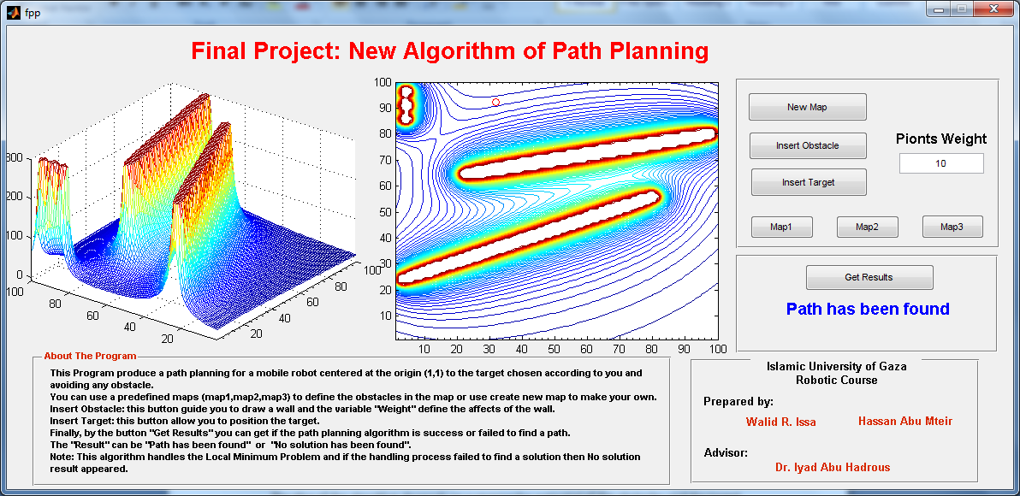
Matlab Test

Slide 16
Conclusion:
In this project we propose an algorithm to find a path of a robot to the target avoiding any obstacles and solving the local minimum problems that may be faced.
The idea of the algorithm depends on summing the potential of the obstacles and the target then finding the path at the points where the potential is minimum.
The results of the algorithm were very successful.
The disadvantage of this algorithm is the robot must know its location and the target location beside the obstacles to get the path.

Slide 17
References:
www.wseas.us/journals/saed/saed-45.pdf
Matlab Help Center.

Slide 18
Thanks !!

